Slide 1
OSCAL, Integrated Testing and Automation
Notes:
Mainly a software developer, attempt to lower the bar on presentation quality While working on sic came across CDS presentation, talked to Damien about it, exploring integration for the past month

Slide 2
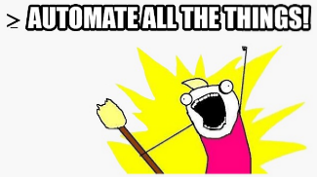
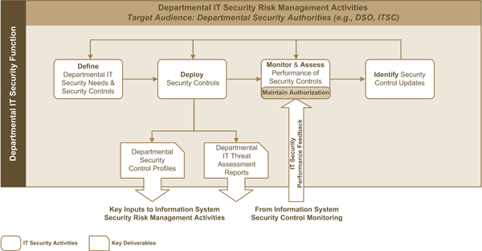

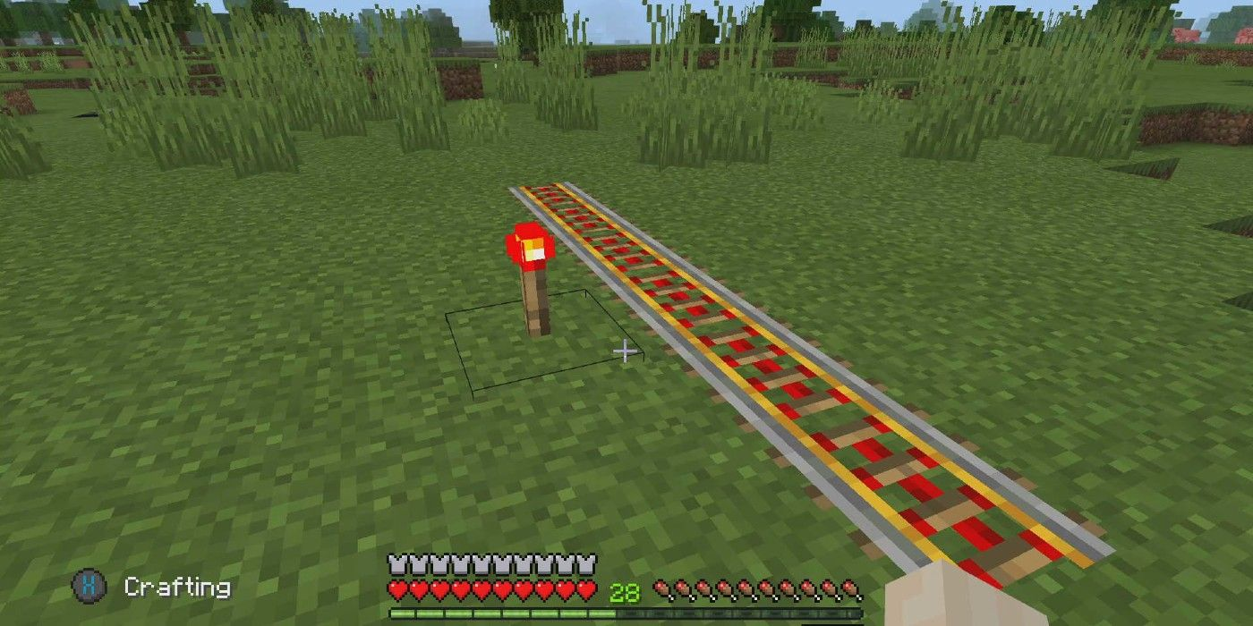

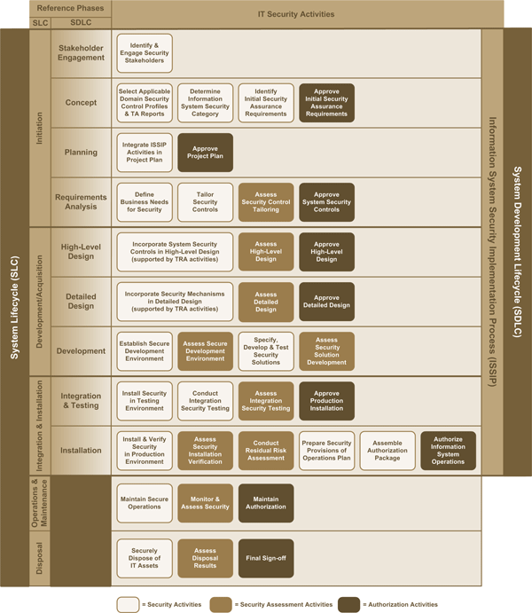
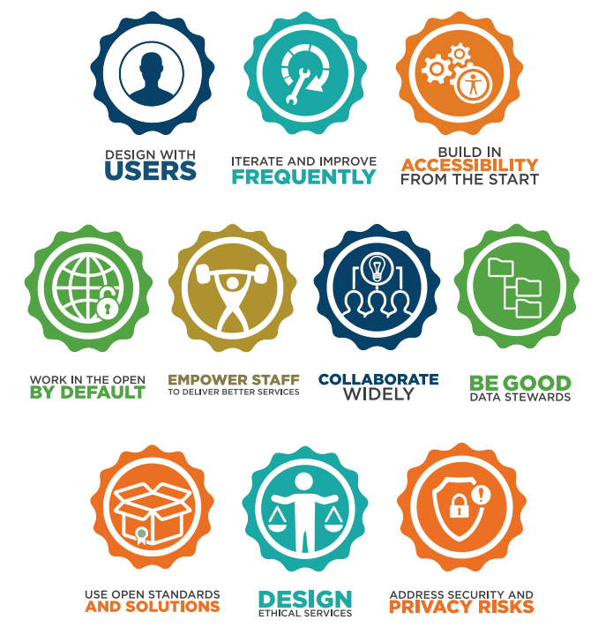
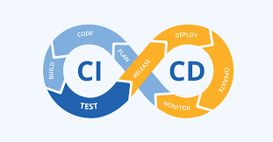

DevSecOps an approach to culture, automation, and platform design that integrates security as a shared responsibility throughout the entire IT lifecycle
Notes:
These assumptions as a software developer

Slide 3




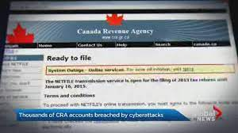
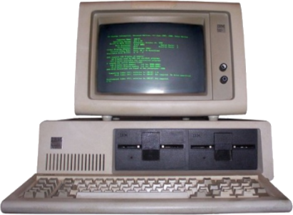
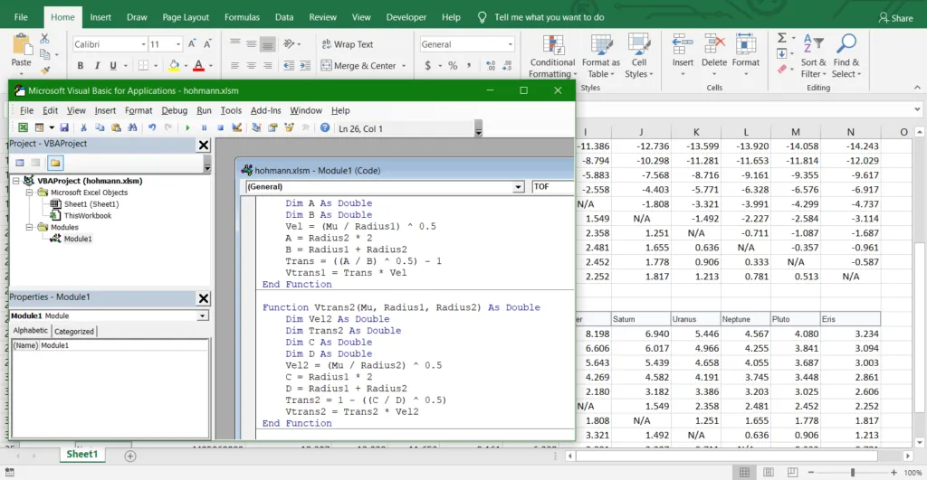

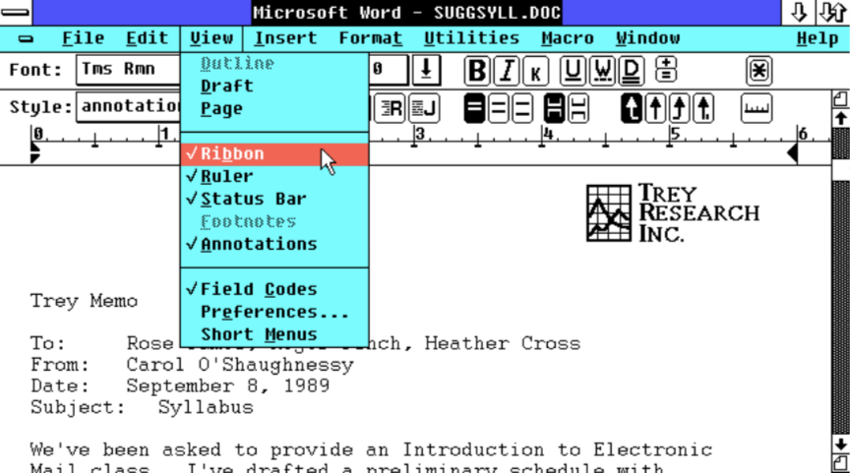

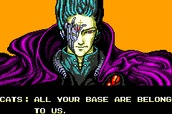
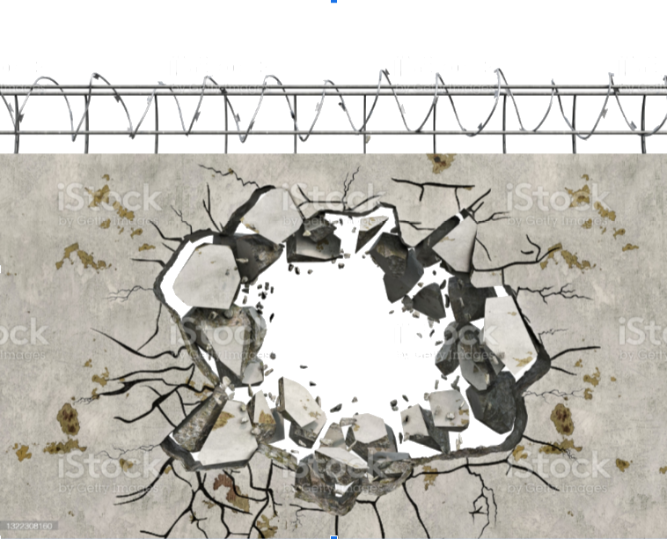
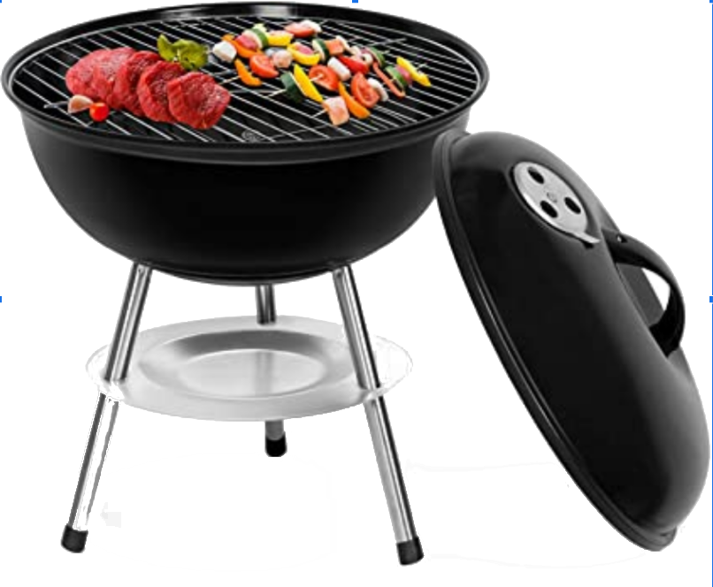
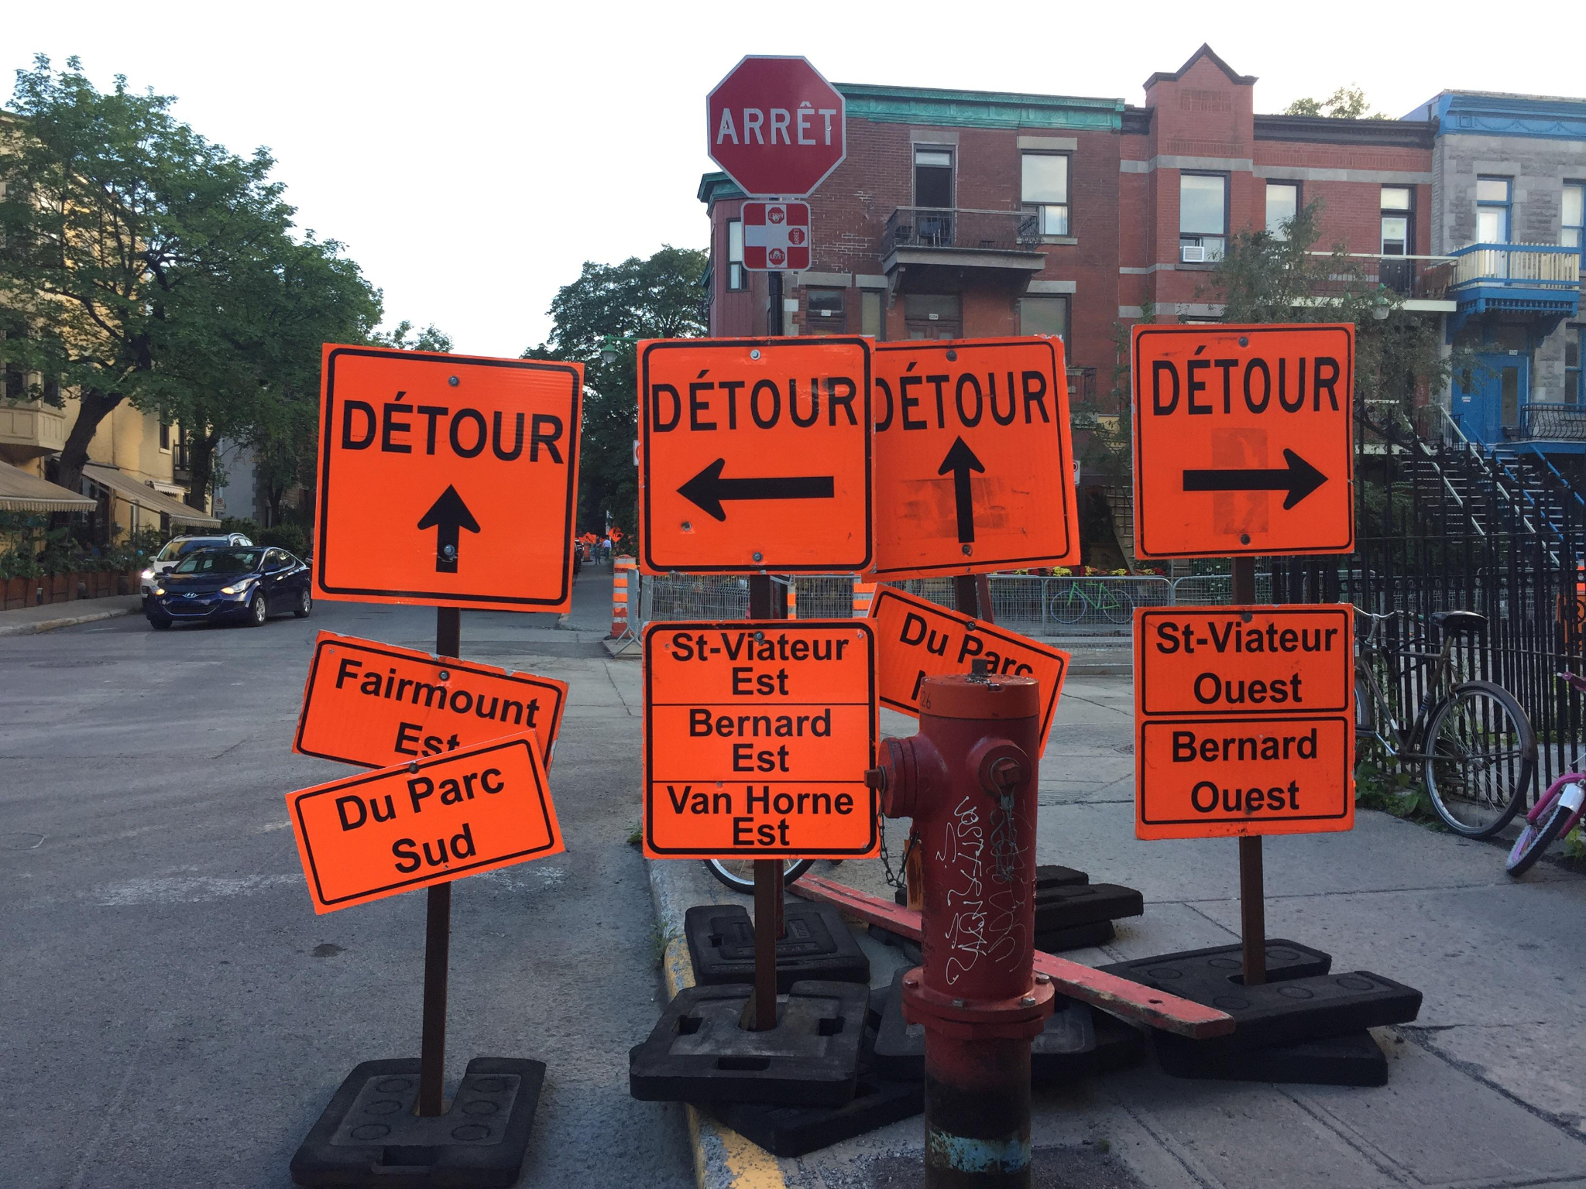

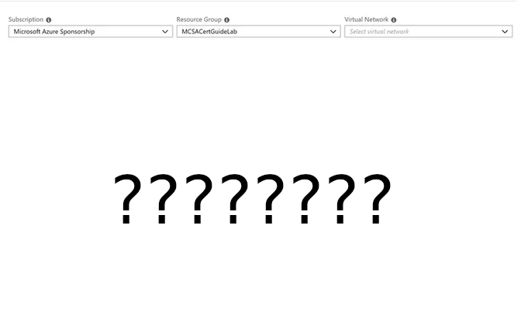
Notes:
Emphasize consultant comments

Slide 4
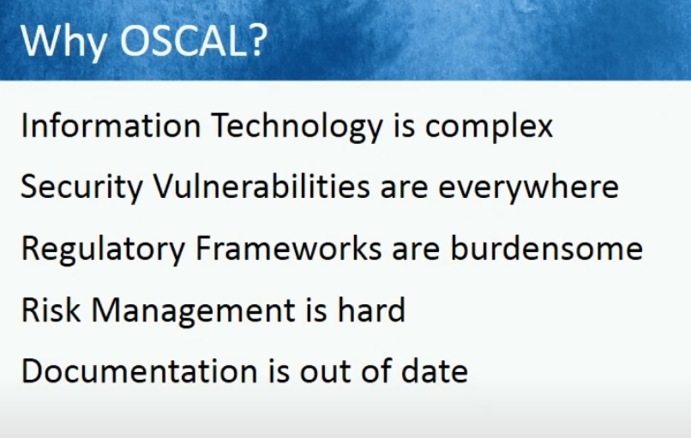
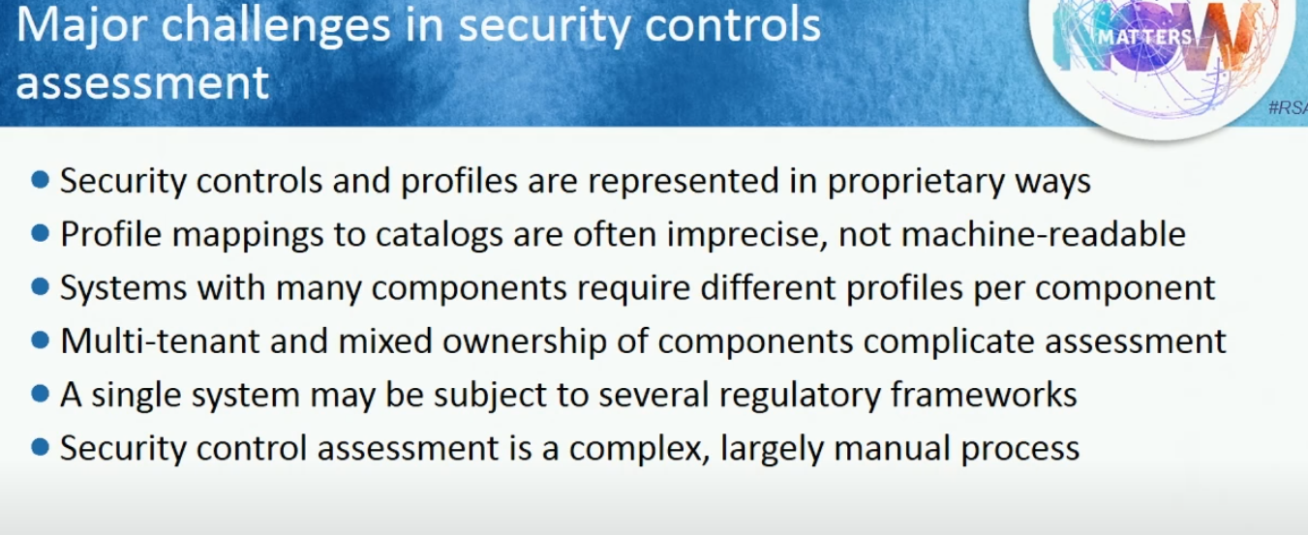
OSCAL - Open Security Controls Assessment Language
Tool builders can provide widely interoperable controls, components and interfaces based on OSCAL standards
Instead of Excel spreadsheets, Word documents: consistent, machine readable data created with user friendly, guided interfaces
Version 1.0 as of June 2021 includes assessments
Version 2.0 supports eg SCAP
https://github.com/cds-snc/security-goals-demo, https://docs.google.com/presentation/d/1c2XJEpxPh_3iBMHsfUEtBQKWMlJCzpgd1I2g0j2bEHA/edit#slide=id.g4cea57f733_0_0
Notes:
Emphasize why oscal? It’s a solution to these problems

Slide 5
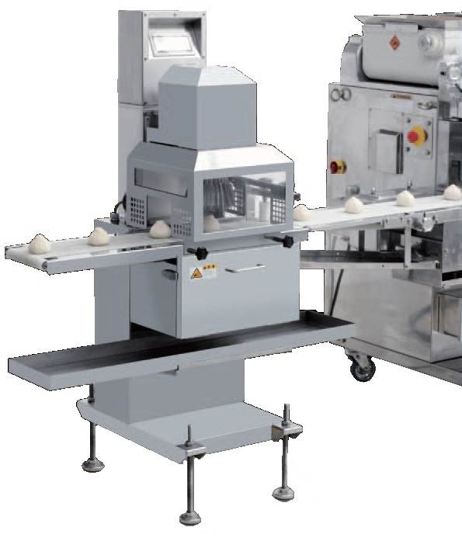

The solution?
✨ PoAMATIC ✨
× OSCAL
Validates SCTM, runs corresponding automated tests and processes, and generates a PoAM.
Notes:
Think of poamatic as a bun making machine. Plan of Action and Milestones being a key delivery tool, with these ingredients

Slide 6
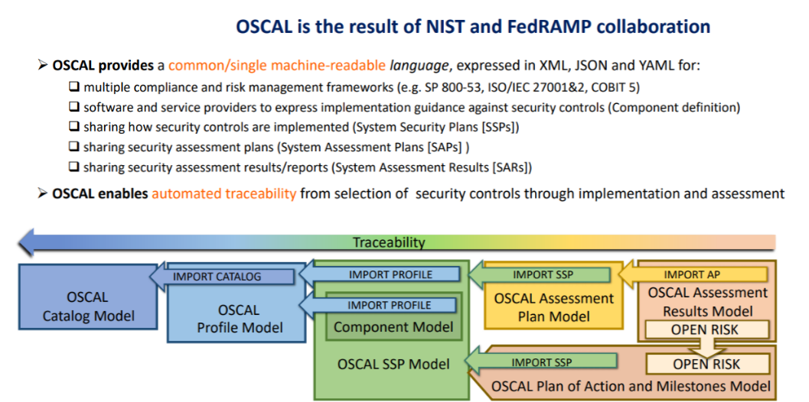
https://www.nist.gov/system/files/documents/2021/02/25/Day1.1-Michaela-OSCAL%20Overview.pdf
Notes:
Provides an interoperable language that expresses consolidated frameworks, Supports automated traceability Diagram shows right to left dependency, PoAM from catalog

Slide 7
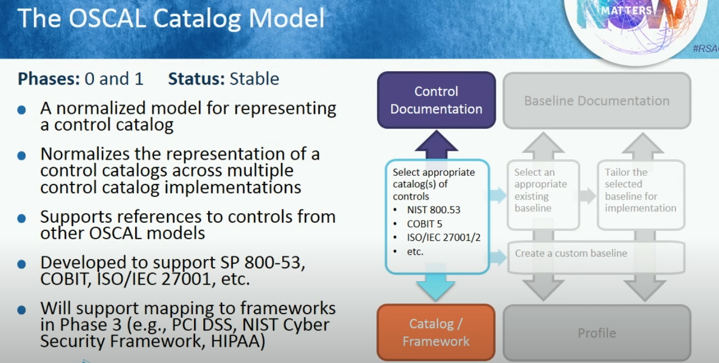
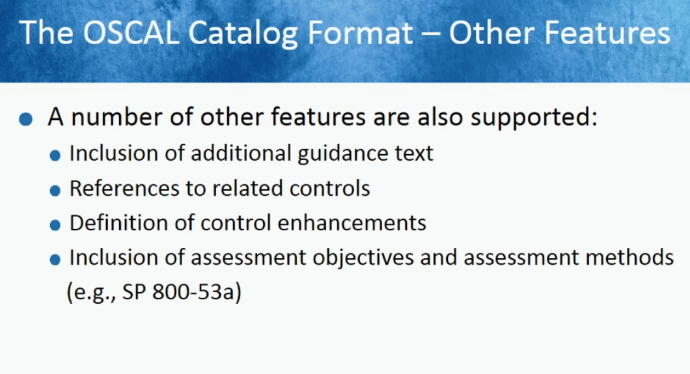
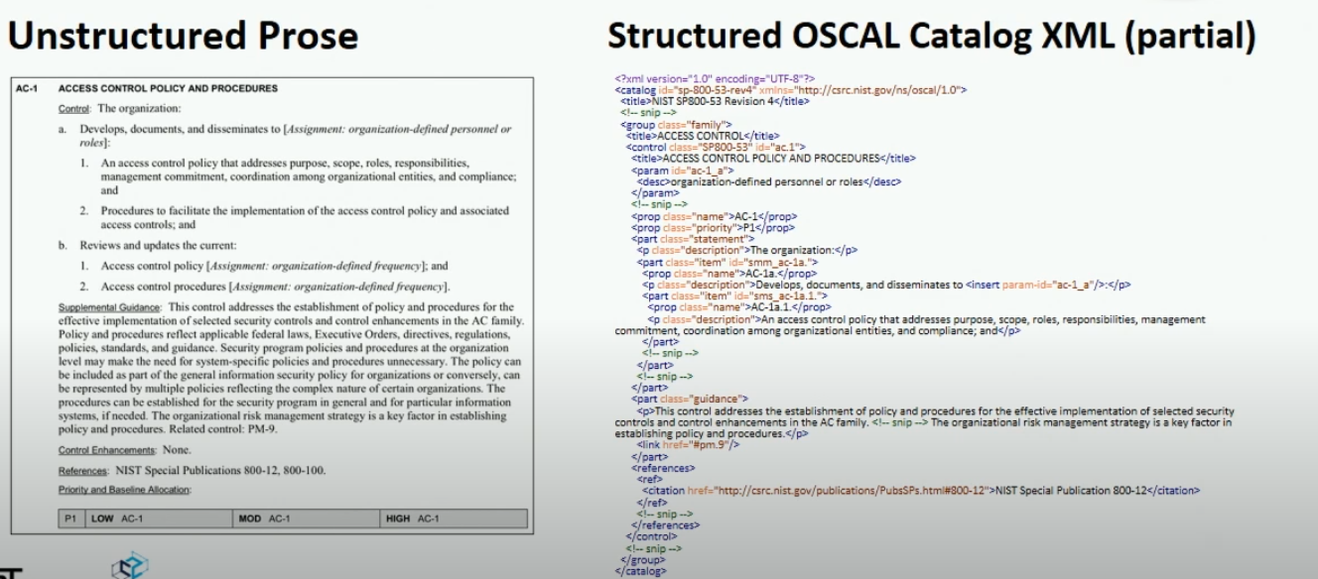
Links support relationships
Notes:
Supports multiple frameworks guidance

Slide 8
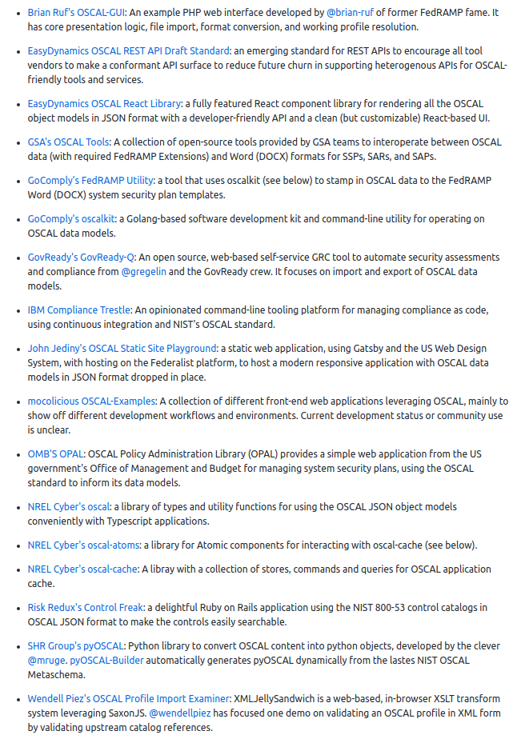
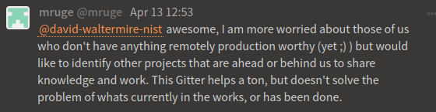
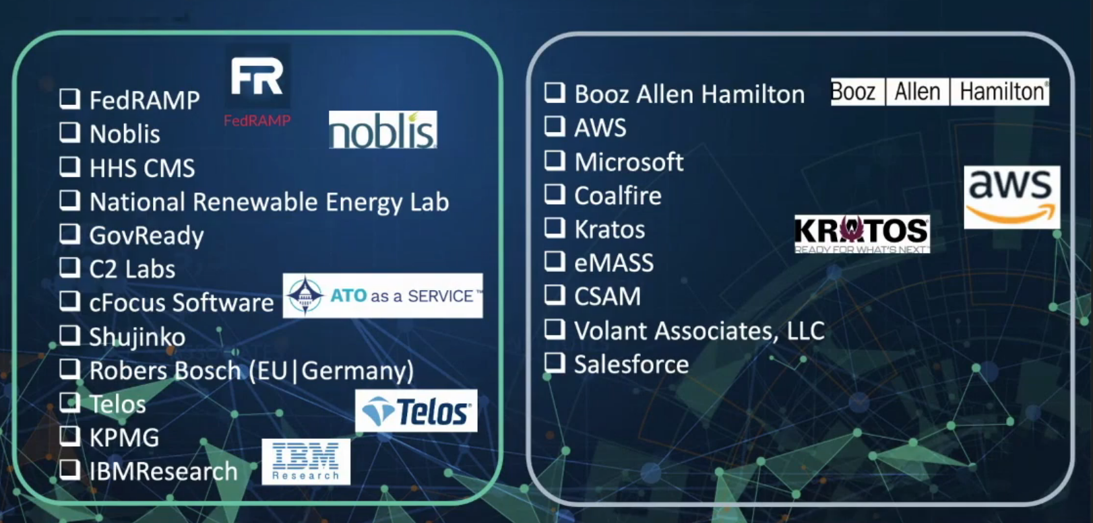
State of OSCAL

Slide 9
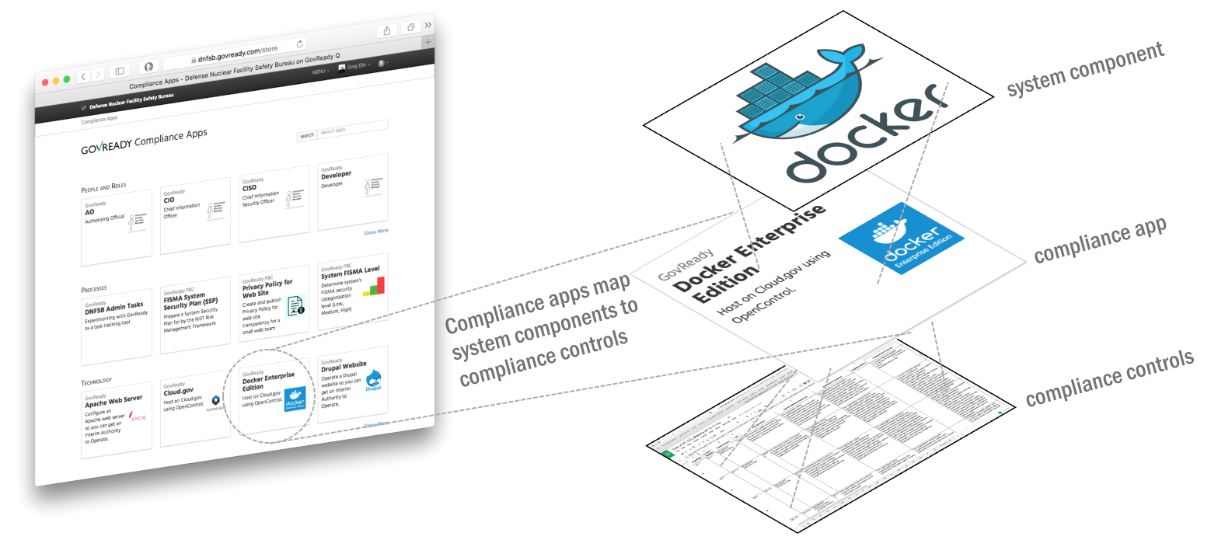
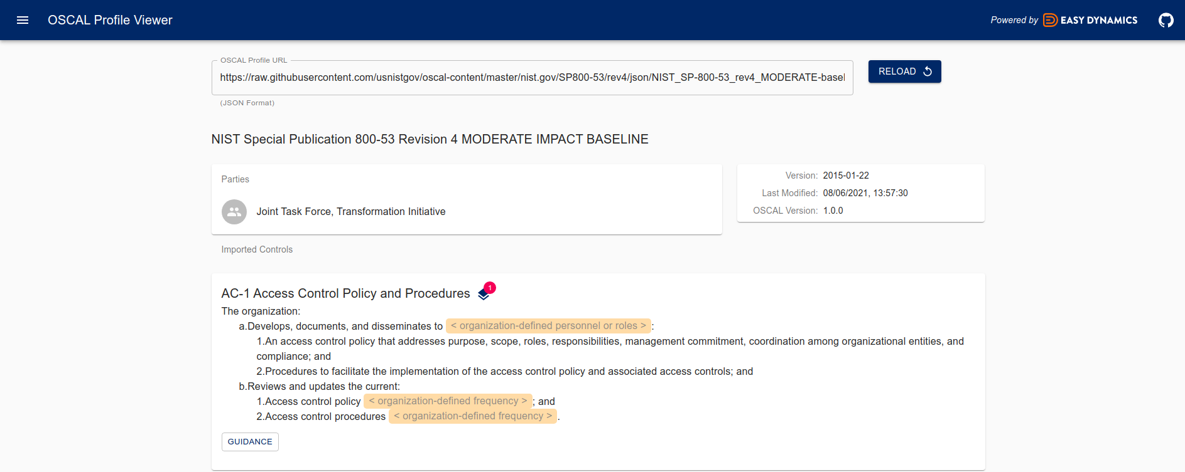
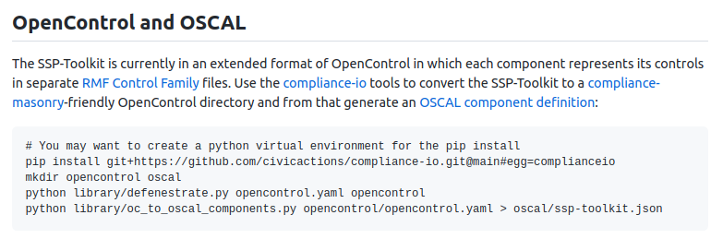
OSCAL tools and tooling

Slide 10
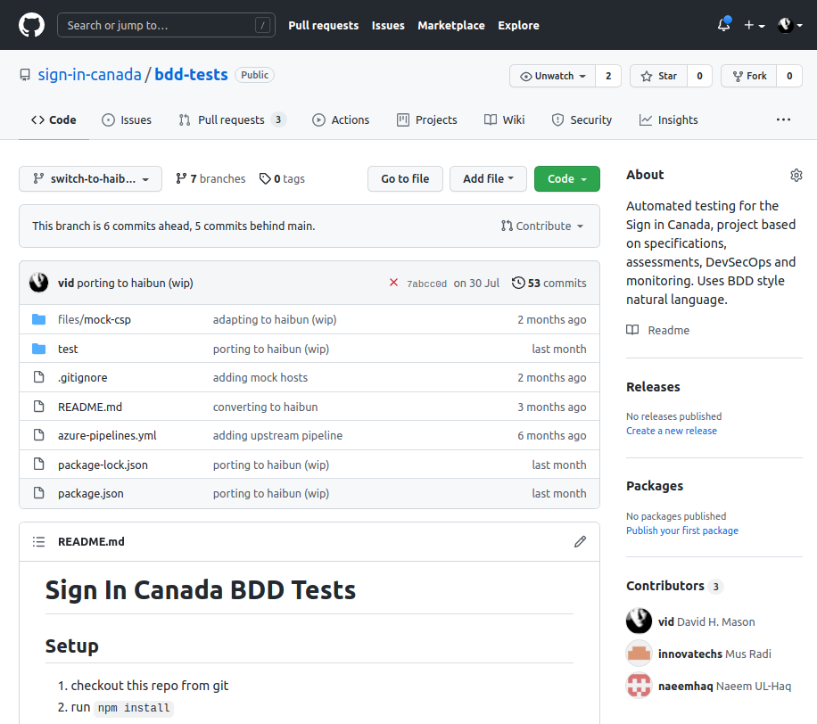
Automated testing: working toward an OSCAL world
✨ PoAMATIC ✨
Notes:
PoAMATIC comes from work creating comprehensive tests for sign in canada

Slide 11
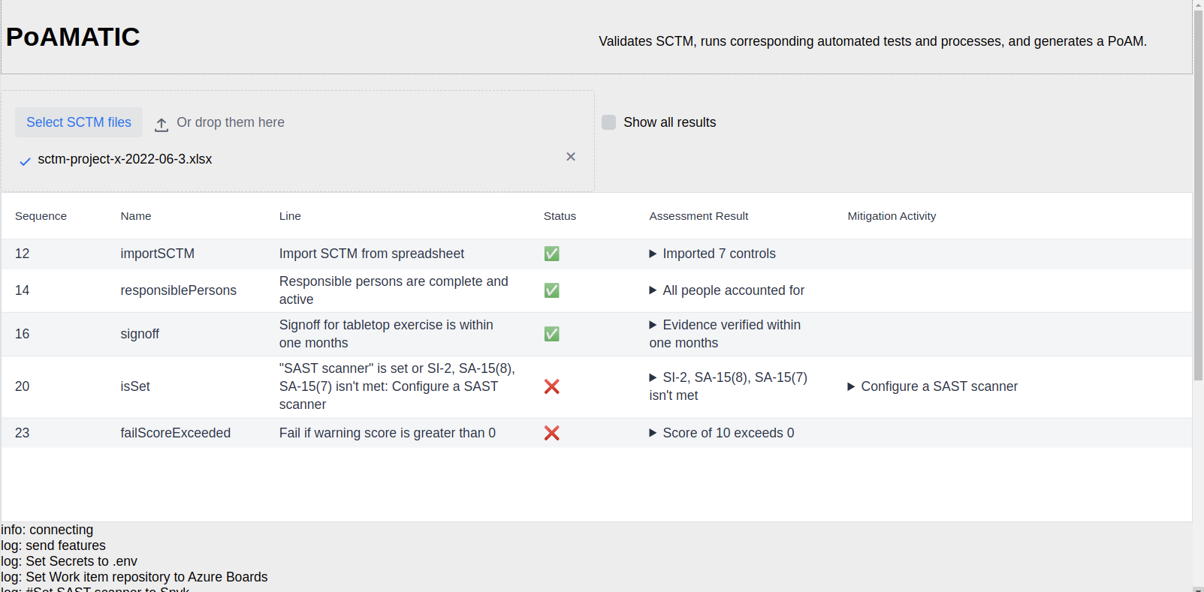
Notes:
Dragged and dropped sctm

Slide 12
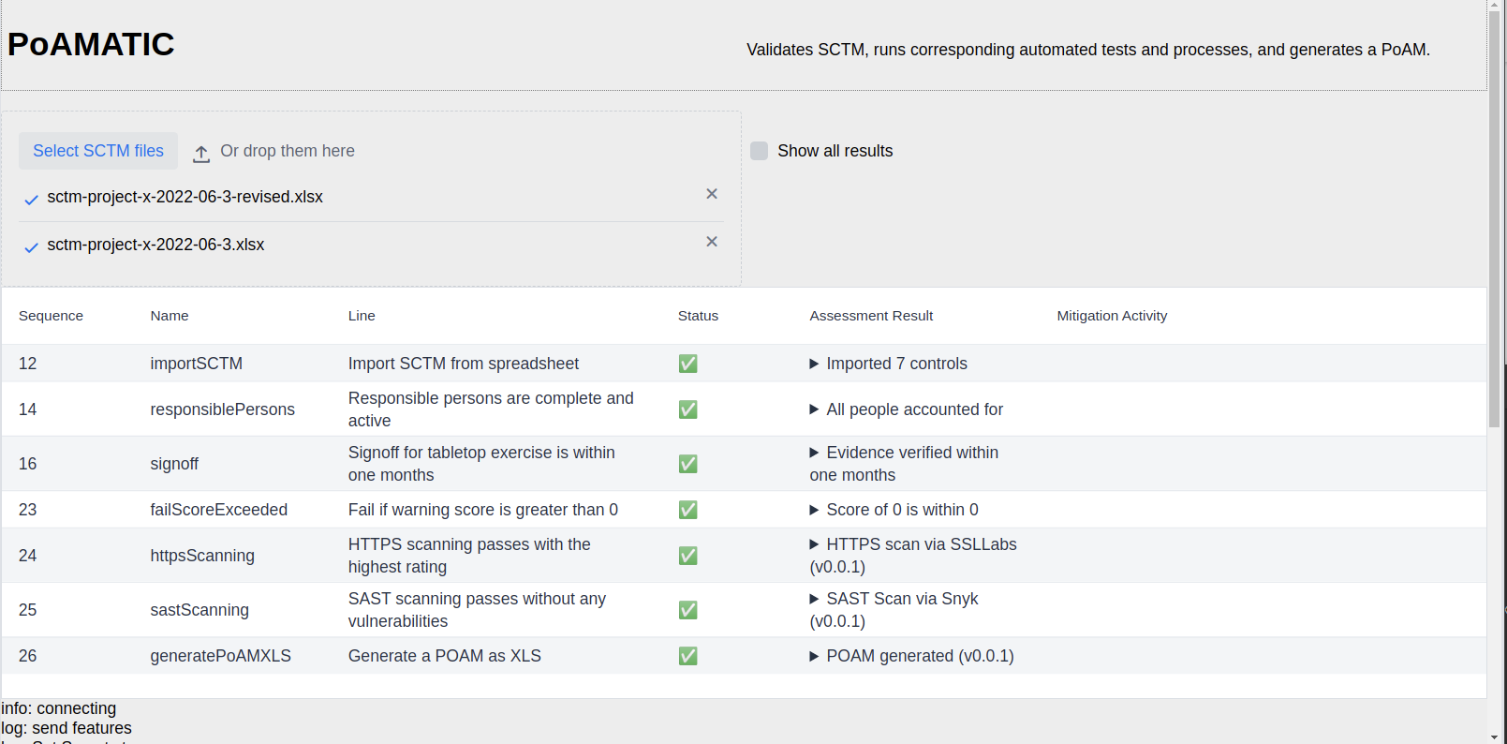

Slide 13
Design
Based on observations of practical approach for today
Eg use SCTM spreadsheet for input instead of complex form
PoAM focused manual and automated assessments and testing
Combine documentation with tests
Run on anyone’s desktop easily, containers, pipelines, monitoring
Uses high level language with minimal code

Slide 14
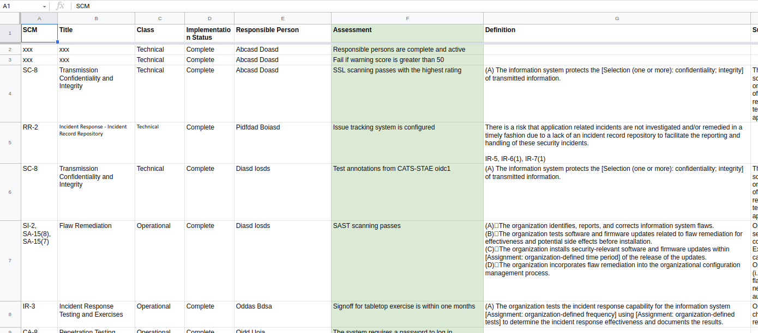

Slide 15
A PoAMATIC script
Project level configuration. Set Secrets to Azure Vault
Set Work item repository to Azure Boards
Set SAST scanner to Snyk
Set HTTPS scanner to SSLLabs
Set PoAM writer to Excel
Set Code repository to https://github.com/canada-ca/poamatic-projectx
Retrieves a spreadsheet, verifies elements are recognized, then imports column data.
Import SCTM from spreadsheet
Tests that each column in the "Responsible Person" column is complete and that each person is a member of the organizational directory.
Responsible persons are complete and active
Checks that a result file is present in a location.
Signoff for tabletop exercise is within one months
Assessors run, first ensuring their environment is complete, providing hints on proper configuration. Good opportunity to hyperlink to specs.
Assessments can pass completely, fail completely, or pass with a warning score.
Fail if warning score is greater than 0
HTTPS scanning passes with the highest rating
SAST scanning passes without any vulnerabilities
Generate a POAM as XLS
Acts as an interactive notebook
Configurable for each type of assessment
Notes:
Can be ready by anyone, executed with versioned modules

Slide 16
Advantages
Project repos include only test cases with module versions
Process is inherently test-driven, with guidance
Declarative style is straightforward
Easy to add new tests, build on existing, versioned with repo, modular
Opportunity to work toward OSCAL process and standards for interoperability

Slide 17
Project setup
Project - High level language
Project specific repo - Haibun modules
General Haibun modules https://github.com/withhaibun/haibun/tree/main/modules
Versioned with minimal deps

Slide 18
OSCAL adaptation
SCTM spreadsheet validates against OSCAL format controls
Produce OSCAL profiles for use in ecosystem
Use OSCAL components, ecosystem of tools, such as assessments, that speak OSCAL
Eventually, eliminate spreadsheets and Word docs, or link them “live”

Slide 19
Follow up
Life as an open source project
In depth live demo
Connecting to projects

Slide 21


